Slide 1
Business Opportunities in Spring Branch, Houston, Texas
By: Ted Jose
05 May 2020

Slide 2
Introduction

Slide 3
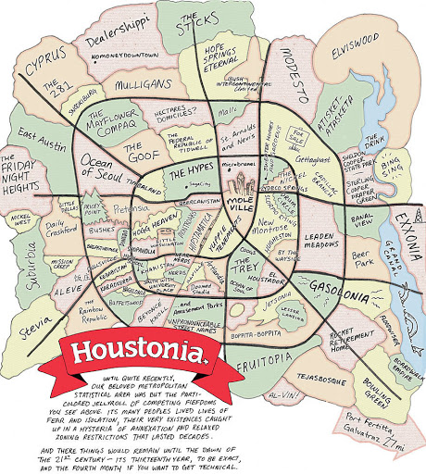
Houston, Texas
Houston Info
2.3 million people
Minority-majority city
Most linguistically diverse in the world
Largest city in US by total area
Diverse Economy
Trade, Transportation (19.8%)
Professional Business Services (16.5%)
Government (13.1%)
Education (12.7%)
Spring Branch Info (Ocean of Seoul)
Melting pot of Korean, Polish and Hispanic immigrants

Slide 4

What type of business do I Open?
I recommend:
Yoga Studio
Bar
Gastropub
Garden Center

Slide 5
Data acquisition and cleaning

Slide 6
Data Acquisition
1. Houston data that contains list Zip Codes, Neighborhoods.
Data source : https://www.houstoniamag.com/home-and-real-estate/2019/03/neighborhoods-by-the-numbers-2019
Description: This data set contains the required information. And we will use this data set to explore various neighborhoods of Houston.
2. Most common venues in each neighborhood of Houston.
Data source : Foursquare API
Description: By using this API we will get all the venues in each neighborhood. We can filter these venues to get most common venues.
3. GeoSpace data
Data source : https://public.opendatasoft.com/explore/dataset/us-zip-code-latitude-and-longitude/table/
Description: By using this geo space data we will get the Houston Zip Code that will help us visualize choropleth map.

Slide 7
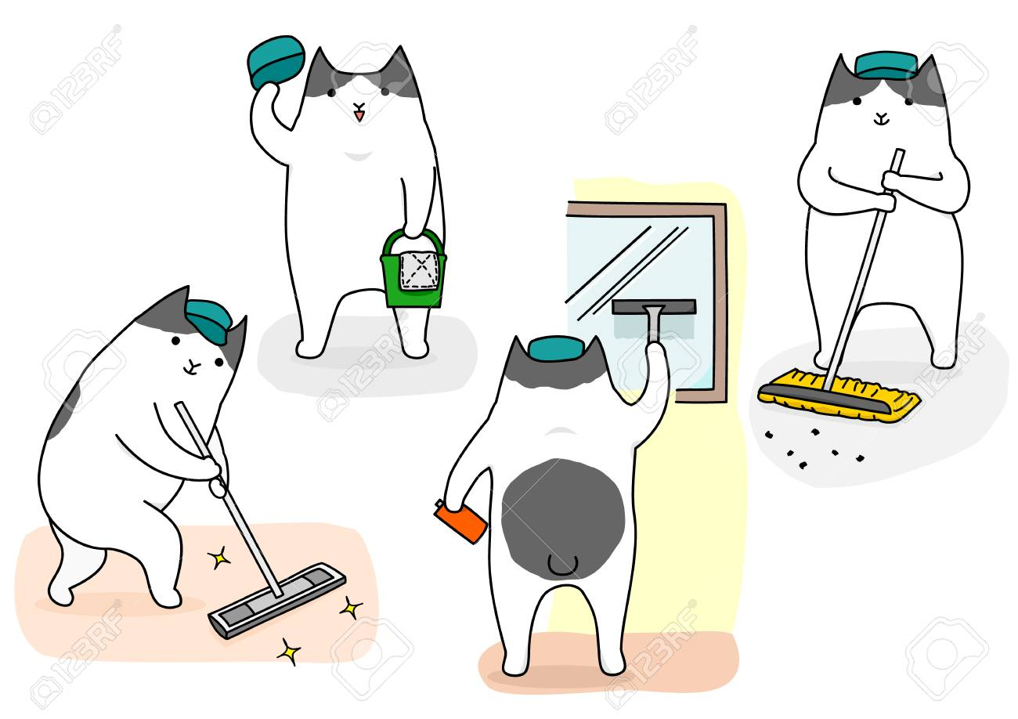
Data Cleaning
Spring Branch located between inner city and suburban living
Aggregate selected neighborhoods
Spring Branch
Adjacent neighborhoods
Developed suburbs
Compare top 10 venues for selected neighborhoods for possible Business Ventures
Weight findings to normalize data

Slide 8
Results

Slide 9
10 most common Venues for Spring Branch, Adjacent Neighborhoods, and Developed Suburbs

Slide 10
Weighted Results

Slide 11
Highlighted Data
Well represented venues are in the top 5 Spring Branch and top 10 of the Total Data set. These businesses are well represented and have the lower potential to be a successful business. The venues identified are Restaurant, Food, Bank, and Mexican Restaurants.
Represented venues are in rankings 6 – 10 Spring Branch and top 10 of the Total Data set. These businesses are represented and have medium potential to be a successful business. The venues identified are Yoga Studio, Gas Station, Gastropub, Garden Center, and Flea Market.
Under represented venues are not top 10 venues in Spring Branch and top 10 of the Total Data set. These businesses are represented and have higher potential to be a successful business. The venues identified are Bar, Spa, and Parks.

Slide 12
Conclusion

Slide 13

Open a Yoga Studio, Bar, Gastropub, or Garden Center
The growth in Houston has brought gentrification of many neighborhoods. Spring Branch is in the early stages of gentrification and a business that can bridge the gap between culturally and economically diverse communities has the opportunity to do well for years to come.
I recommend opening a Yoga Studio, Bar, Gastropub, or Garden Center in Spring Branch.
To elevate this study to the next level validating model by cross referencing other data sources, review recently submitted business permits in Spring Branch, and market research on convenient locations and need.

